Slide 1
Data-Driven Safety Analysis (DDSA)
Implementation Plan
Notes:
2 or 3 years ago I was given the opportunity to attend a Pear Exchange with other states on DDSA. It was a familiar topic to HSIP group, but the Peer Exchange focused on developing a plan for implementation in project development.
We thought DDSA implementation was a good opportunity to improve how we address safety needs, but we also knew there were some obstacles, two of which were training & tools .
After the peer exchange we didn’t really work on an implementation plan, but advancements were being made to put KYTC in a better position to develop a plan.
The Partnering Conference last year focused on Safety. If you were there you may have heard John Moore mention developing an implementation team.

Slide 2
What is DDSA?
Data-driven safety analysis (DDSA) uses newer, evidence-based models that provide the ability to quantify safety impacts similar to the way they do other impacts such as environmental effects, traffic operations and pavement life.
Notes:
In the past, we’ve looked at critical rate factors to help us identify potential safety needs. Usually, we addressed the safety needs by addressing geometrics that were below standard. But we didn’t have a good way to measure how effective the project would be.
With the publication of the Highway Safety Manual (HSM), we had the opportunity to utilize science-based data (from case studies) to compare the safety performance of roadways to other roadways of similar types and to predict the safety performance of different alternatives.

Slide 3
Why DDSA?
Informed Decision-Making. Predictive and systemic analyses improve on traditional decision-making approaches that rely on subjective and limited quantitative measures of safety performance.
Improved Safety. DDSA offers a scientifically sound, data-driven approach to allocating resources to performance-based solutions that result in fewer crashes
Targeted Investment. The analyses allows us to better optimize funding by selecting the most appropriate roadway features and project sites.
Notes:
We have data on how different roadway improvements perform and can quantify potential benefits of a project. KYTC has a comprehensive crash cost for different crash severities and the predicted reduction in crashes can be a crash cost savings. The crash cost savings, along with the user cost savings, can be compared to the cost of the improvement.
Allows us to better determine performance based flexible solutions. Cost-savings allows more funding for other projects.

Slide 4
Balance
Mobility
Utility Impacts
Connectivity
Costs
Capacity
Right-of-Way
Safety
Environment
What Do You Do?
Notes:
This implementation plan focusses on how we perform and use the safety analysis in our project development process. I always try to emphasize, that while safety is very important, it’s not our only consideration. We don’t always choose the project with the least number of predicted crashes. There are many other things to consider.

Slide 5
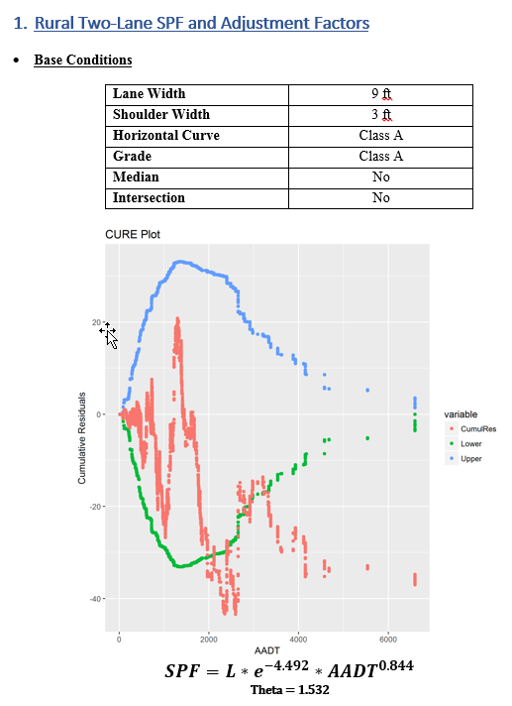
Recent Developments
KY Safety Performance Functions (SPFs)
and Adjustment Factors
Notes:
KTC has developed KY SPFs for most roadway facilities. We have these available and will place them on the webpage when we figure out how to do that. If you would like the SPFs before our webpage becomes operational, let me or Mike Vaughn know.

Slide 6
Notes:
Here is an example of an SPF for Rural Parkways in Kentucky. I know all of you are probably familiar with Critical Rate Factor (CRF). The information obtained from an SPF is used similar to CRF data. At the most basic level, we use both SPF and CRF to determine which sites have more crash history than we would expect. Essentially, an SPF is the line of best fit for our crash and roadway data. AADT is on the x-axis and crashes per mile (5years) is on the y-axis. Any dots above the SPF line are sites that have more crashes than would be expected (excess expected crashes) or predicted from the model and any dots below the line are sites with fewer crashes than would be expected. Similarly, a site with a CRF above 1 tells us that site has more crashes than average, and a CRF below 1 tells us the site has fewer crashes than expected. The big difference between SPF and CRF is that SPFs are NOT linear, while CRF assumes crash rate increases linearly as AADT increases. The research behind SPFs shows that crash performance is not linear. In this example crashes increase somewhat exponentially as AADT increases.

Slide 7
Recent Developments, cont.
Planning and Design Level CMFs
EEC, formerly PCR, used for SHIFT and will be used for network screening
SPF spreadsheets
Crash Data Access Tool (CDAT) - coming in June 2019
HIVEi
HSM training and Webinar (https://www.youtube.com/watch?v=7qE9jMouP_g)
Beginning to use HSM analysis and benefit/cost in the design process to better inform decision making
Notes:
Planning level CMFs were developed for the Planning and used in the SHIFT process to calculate benefits of project types. There is a research project underway to develop design level CMFs for our use. The Clearinghouse is a great resource, but it is so large and it can be cumbersome to find the best CMF for use without spending a lot of time.
The KY SPFs were used to determine Excess Expected Crashes (EECs) for SHIFT projects used for the safety component of the SHIFT process.
CDAT is a tool similar to the HIVEi. It’s being developed by KTC. Crash data can be accessed by entering a county, route, milepoint. It summarizes by different categories, such as type of crash. It can also provide an EEC.
HIVEi is similar. It is currently available to KYTC only, but will soon be available to those consultants that have signed MOUs with It has some filters that can be toggled on/off. It provides a link to the police report. It doe not include all the fields in KYOPS.
Training – have offered a few classes that cover HSM, spreadsheets, and IHSDM. Plan to have another training in the spring.

Slide 8
Example of Alternative Comparison
Notes:
Here’s an example of one way I’ve seen the HSM used in selecting a project alternative. Interstate widening with a 4” vs. 10’ inside shoulder. The two templates were compared to the future no-build predicted EEC and a cost benefit was calculated. The 4 ft. inside shoulder option was selected. There was around a $55 M cost difference.

Slide 9
How? We need a plan.
DDSA Implementation Team Kick-Off Meeting held November 1, 2018
Subcommittees formed
Planning (Deanna Mills)
Highway Design (Wendy Southworth & Jill Asher)
Safety Analysis Tools & Training (Nathan Ridgeway)
Fostering DDSA Culture & Marketing (Jason Siwula)
Safety Data Webpage (Jarod Stanley)
Notes:
Each subcommittee has met or will be meeting soon.
A second DDSA Implementation Team meeting was held earlier this month. The subcommittees reported back and we came up with some outstanding items that need to be addressed before we draft a plan.

Slide 10
What will be in the DDSA Implementation Plan
How will the need for safety improvements be identified?
What level of safety analysis is needed for different types of projects or planning studies? What about maintenance projects?
How will we communicate results of predictive safety analysis to the public?
Who is going to perform or review the analysis?
Will there be a prequalification requirement?
What tools and training will be available?
Notes:
When should we include safety as a need in our purpose and need statement?
We are considering Tiers of safety analysis which would provide a recommended level of safety analysis.
We are considering a Level of Service for Safety similar to the capacity performance measure of LOS.
IDK. We are recommending that there be 1-2 SMEs available. The Division of Highway Design is currently using a Statewide Contract for Capacity and Safety Analysis for review, training, and analysis.
Not yet. We want our consultants to have the chance to be trained before we require a prequalification for the services.
We’ve had a few training classes through the FHWA resource office and are having another in May. We plan on putting the training material on the safety data website.

Slide 11
Timeline
Our goal is to have a guidance document drafted in time for the Partnering Conference.

Slide 12
Resources
https://safety.fhwa.dot.gov/
https://www.fhwa.dot.gov/innovation/everydaycounts/edc_4/ddsa.cfm
https://www.youtube.com/watch?v=7qE9jMouP_g
Coming soon: KYTC Safety Data Website

Slide 13
If you have any questions or would like to provide input to the team, my contact information is:
Email – jill.asher@ky.gov
Phone – 502 782-4866

